Slide 1


Forest Fire Model and its Self-Organized Criticality
Zhe Sun & Bojun Cheng

Slide 2
Outline
Motivation
Introduction
Simulation results
Conclusion and Outlook

Slide 3
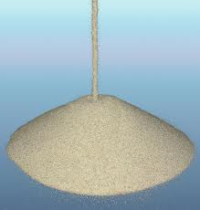
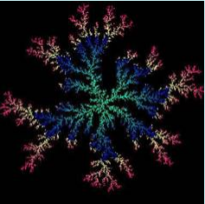

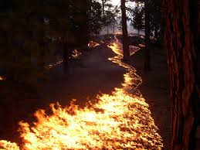
1. Motivation
Self-organized criticality (SOC) can be seen in various systems:
Forest fire is one of the systems
Predict the behavior of a dynamic system
Risk assessment and hazard protection

Slide 4
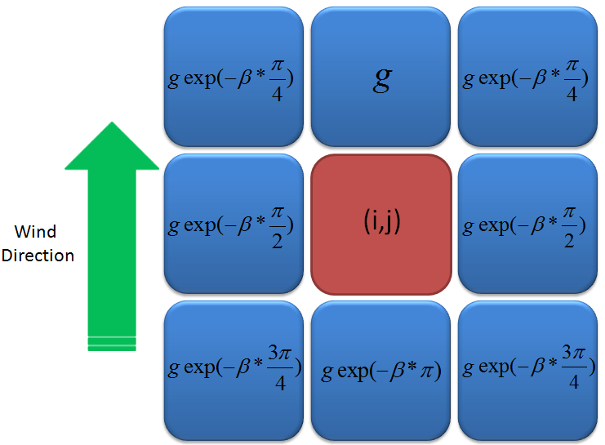

2. Introduction
2.1 Forest Fire Model (FFM)
Forest:
n*n grid
Empty site-0
Tree-1
Burning tree-2
Rules:
(1) A tree can be ignited by lightening with a probability f
(2) A burnt tree will become an empty site
(3) A tree can grow in an empty site with a probability p
(4) A burnt tree will cause fire in its neighboring tree with same probability g
Weather conditions:
Parameters:
size-n
probLightening-f
probGrow-p
probIgnite-g
density-d
wind-β
rain-r
step-N
Wind:
Rain:

Slide 5

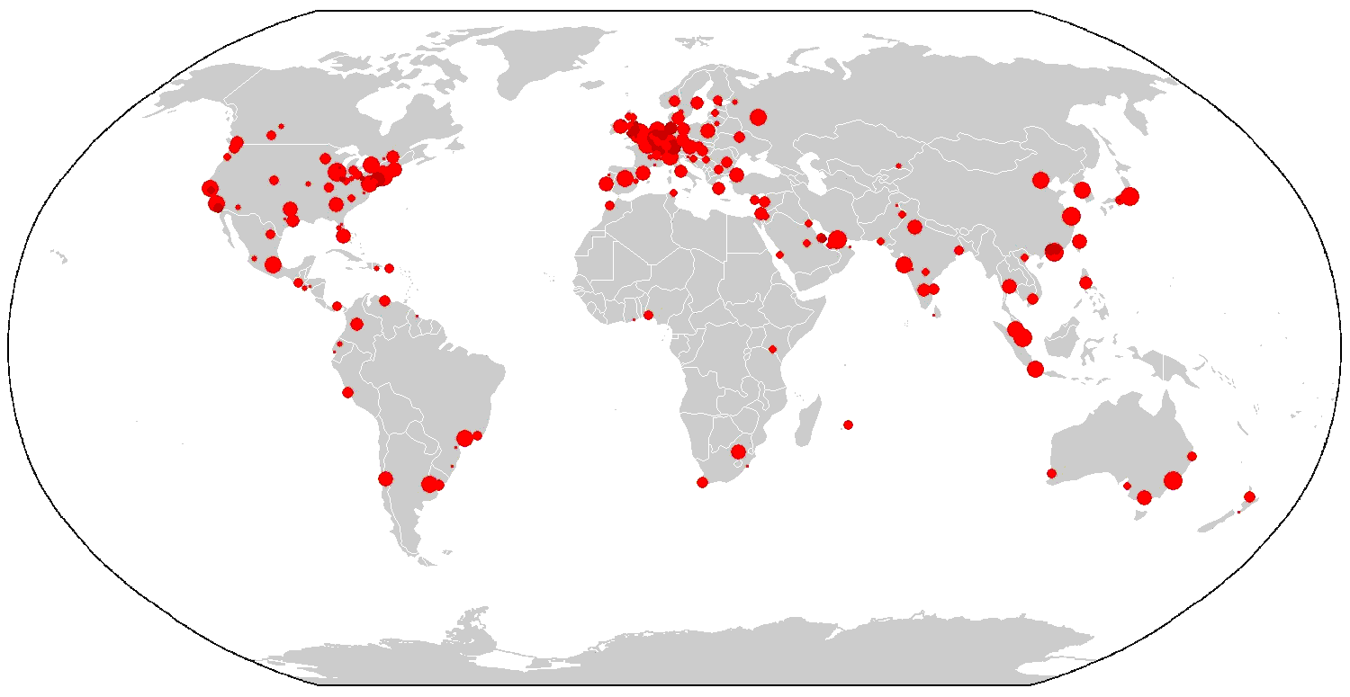
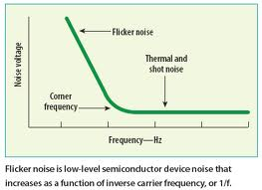
2. Introduction
2.2 Self-Organized Criticality (SOC)
Definition:
A dynamic system can evolve into a non-equilibrium steady state
without tuning its parameters.
Properties:
Long scale temporal fluctuations
Size-frequency distribution satisfies power-law
Flicker noise

Slide 6
3. Simulation Results
3.1 Evolution of forest fire
video

Slide 7
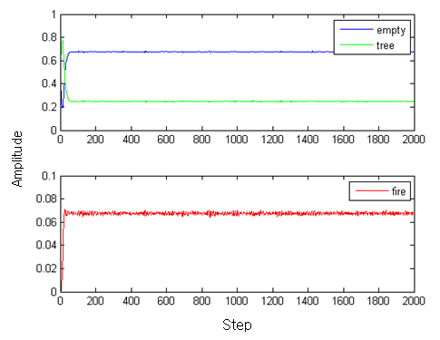
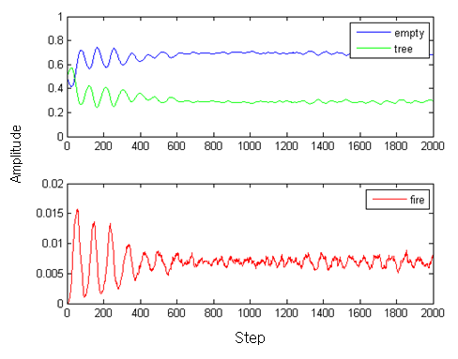
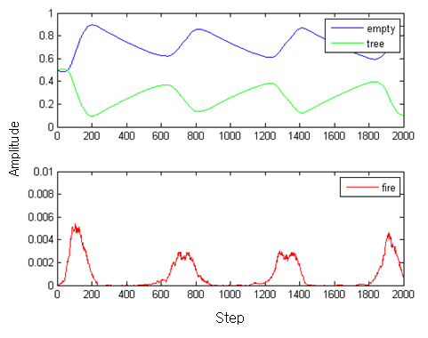
Reminder:
size-n
probLightening-f
probGrow-p
probIgnite-g
density-d
wind-β
rain-r
step-N
3. Simulation Results
3.2 The regime of SOC
Keep p/f= 10³, n=500, d=0.5, g=1,change p
p=0.05
p=10⁻²
p=10⁻³

Slide 8
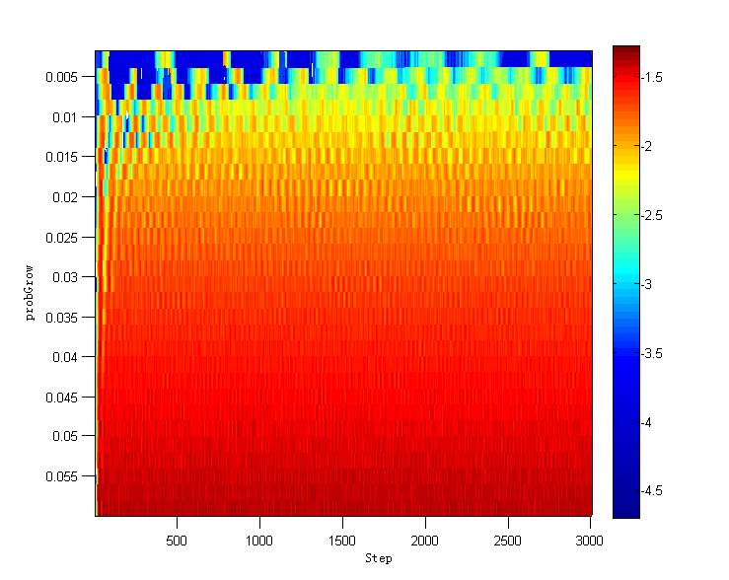
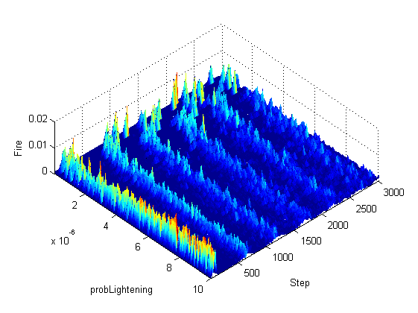
Reminder:
size-n
probLightening-f
probGrow-p
probIgnite-g
density-d
wind-β
rain-r
step-N
3. Simulation Results
3.2 The regime of SOC
ii) Keep p/f= 10³, n=300, d=0.5, g=1, scan p
iii) Keep p=0.001, n=300, d=0.5, g=1,scan p/f
p<0.01
p/f>10³ or f<10⁻⁶

Slide 9
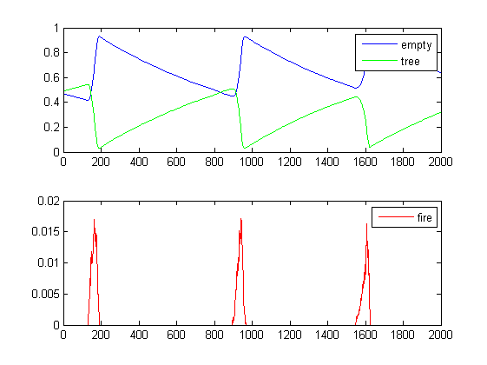
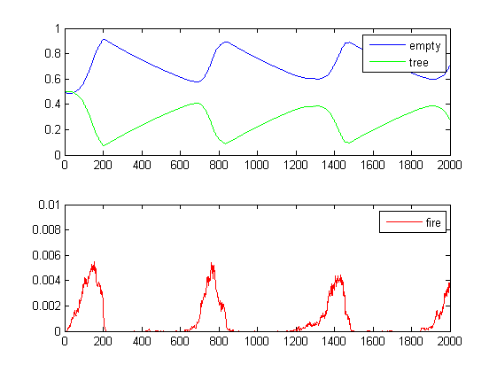
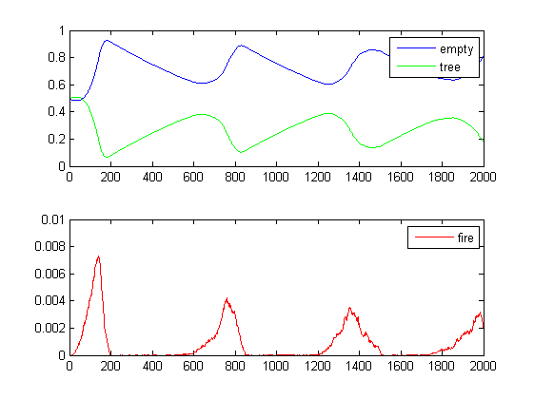
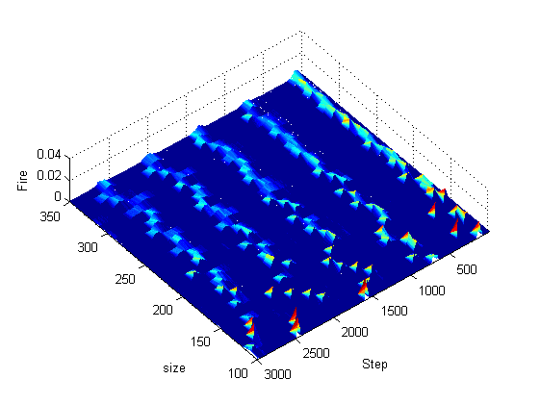
Reminder:
size-n
probLightening-f
probGrow-p
probIgnite-g
density-d
wind-β
rain-r
step-N
3. Simulation Results
3.3 Effect of forest size
Keep p= 10⁻³, f= 10⁻⁶,d=0.5, g=1, change n
(a)
(b)
Amplitude
Amplitude
n=100
n=200
(c)
Step
(d)
Step
decay faster
Amplitude
n=300
c
b
more fluctuated
Step
a

Slide 10
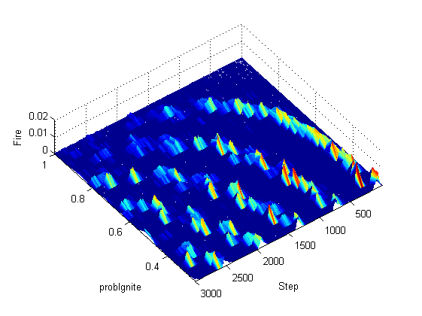
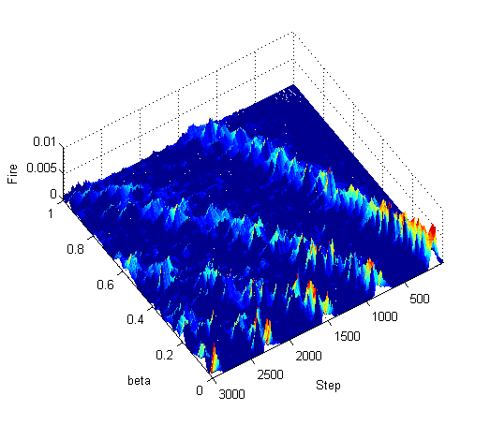
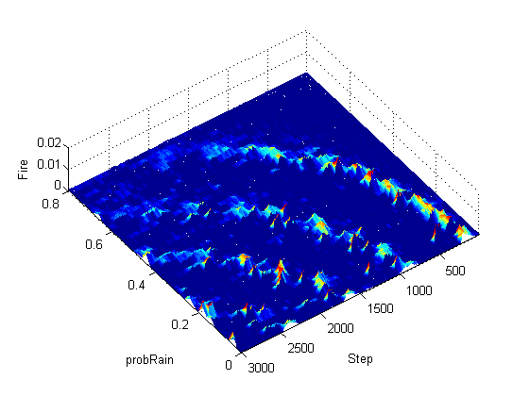
Reminder:
size-n
probLightening-f
probGrow-p
probIgnite-g
density-d
wind-β
rain-r
step-N
3. Simulation Results
3.4 Scan other parameters
Keep p= 10⁻³, f= 10⁻⁶,d=0.5, n=300, scan g, β, r
(a)
0.2
0.4
0.6
0.8
1
(b)
(c)
(c)

Slide 11
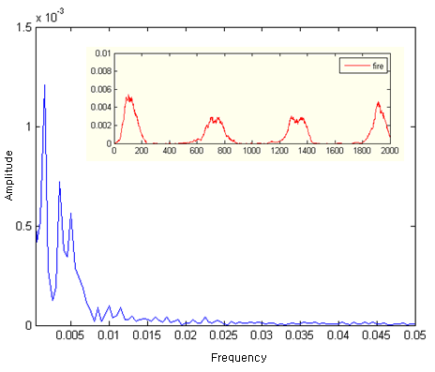
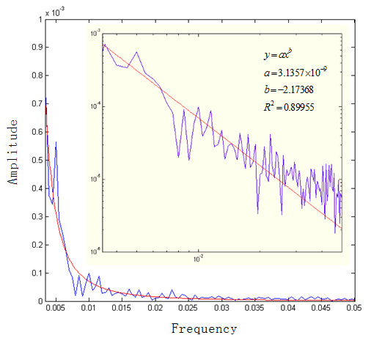
3. Simulation Results
3.5 Flicker noise
(a)
(b)
Noise spectrum ~ f⁻²

Slide 12
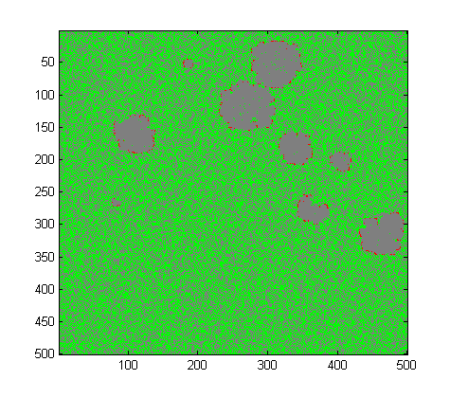
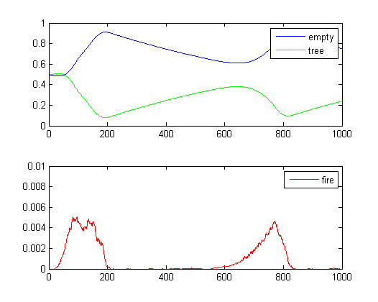
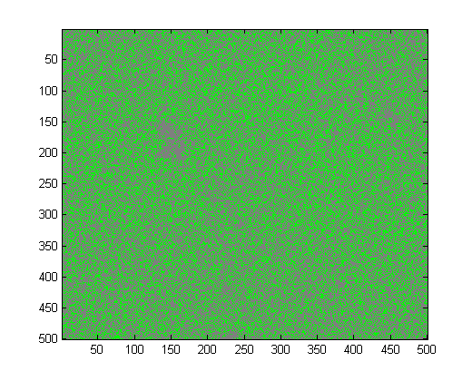
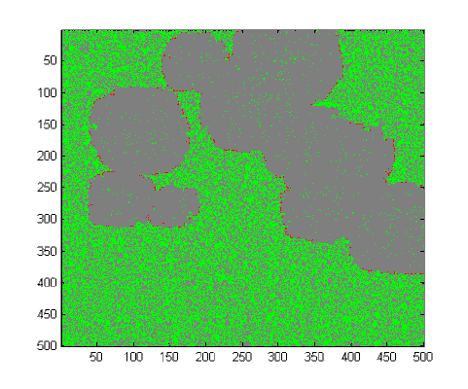
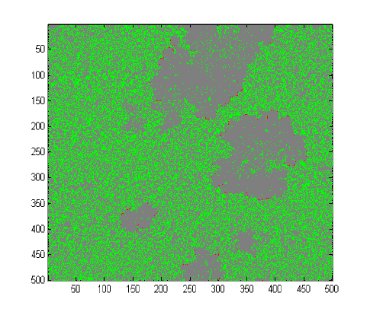
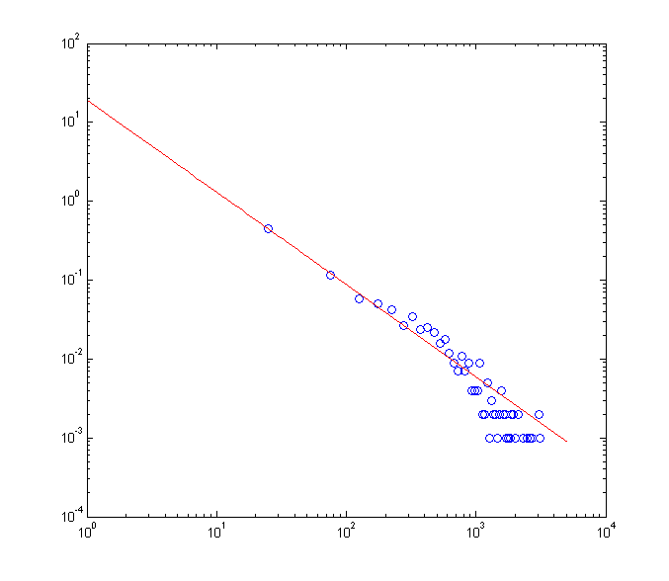
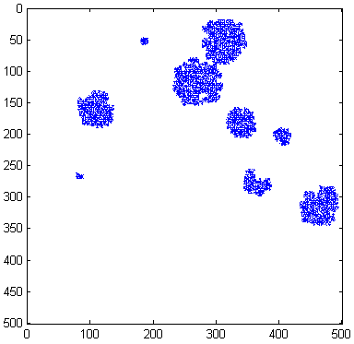
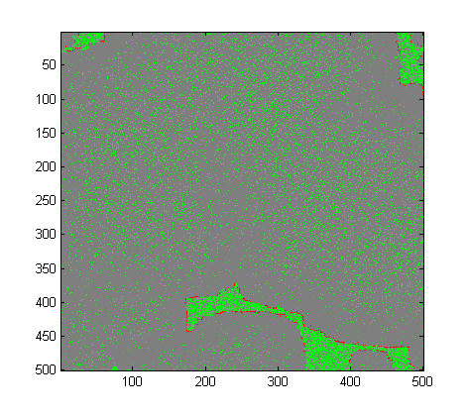
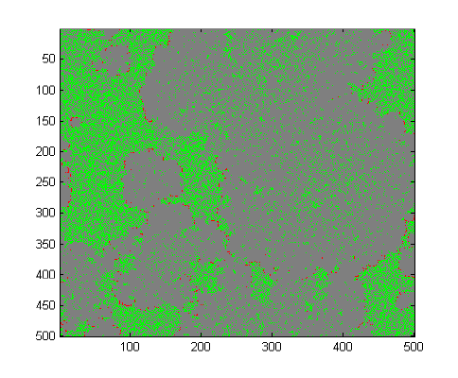
3. Simulation Results
3.6 Size-frequency distribution
(a)
(g)
(d)
Amplitude
100
770
(b)
Step=60
180
550
(e)
Step=550
60
Step
700
(h)
(c)
Step=100
Frequency
Step=700
(f)
Step=180
Step=770
Size

Slide 13
4. Conclusion & Outlook
In this project:
1) We build a FFM based on CA
We scan different parameters to characterize our FFM
We observe the long scale temporal fluctuations of SOC states
4) We observe the ‘flicker noise’ in the noise spectrum
5) We show size-frequency distribution of fire clusters in our FFM satisfies the power-law
More things in the future:
Study larger forest within longer time scale
Consider more factors: landscape, species of tree ……
Scan power spectrum with different parameters
Understand the physical background behind the ‘flicker noise’ and the power-law distribution

Slide 14
Thanks for listening!

